Slide 1

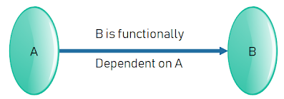
Database Management Systems (BCSC – 1003)
Topic: Functional Dependency

Slide 2

Functional Dependency
The functional dependency is a relationship that exists between two attributes.
It typically exists between the primary key and non-key attribute within a table.
It is usually denoted as: X → Y
The left side of arrow is known as a determinant, the right side of the arrow is known as a dependent.

Slide 3
Functional Dependency
Example:
Assume, we have an EMPLOYEE table with attributes: Emp_Id, Emp_Name, Emp_Address.
Here Emp_Id attribute can uniquely identify the Emp_Name attribute of employee table because if we know the Emp_Id, we can tell that employee name associated with it. Functional dependency can be written as:
Emp_Id → Emp_Name
We can say that Emp_Name is functionally dependent on Emp_Id.

Slide 4
Functional Dependency
Types of Functional Dependencies:
1. Trivial functional dependency
2. Non-trivial functional dependency
3. Multivalued dependency
4. Transitive dependency

Slide 5
Functional Dependency
1. Trivial functional dependency
A → B has trivial functional dependency if B is a subset of A. The following dependencies are also trivial like: A → A, B → B
Example:
Consider a table with two columns Employee_Id and Employee_Name.
{Employee_id, Employee_Name} → Employee_Id is a trivial functional dependency as Employee_Id is a subset of {Employee_Id, Employee_Name}.
Also, Employee_Id → Employee_Id and
Employee_Name → Employee_Name are trivial dependencies too.

Slide 6
Functional Dependency
2. Non-trivial functional dependency
A → B has a non-trivial functional dependency if B is not a subset of A.
When A intersection B is NULL, then A → B is called as complete non-trivial.
Example:
ID → Name,
Name → DOB

Slide 7
Functional Dependency
3. Multivalued functional dependency
When existence of one or more rows in a table implies one or more other rows in the same table, then the Multi-valued dependencies occur.
If a table has attributes P, Q and R, then Q and R are multi-valued facts of P. It is represented by double arrow as → →
Example 1:
P → → Q
P → → R
In this case, Multivalued Dependency exists only if Q and R are independent attributes.

Slide 8
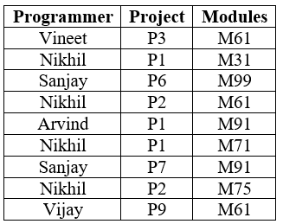
Functional Dependency
Example: Consider following table Prog_Proj below showing Multivalued dependency.
PROG_ PROJ
Here columns PROJECT & MODULES are independent of each other and dependent on PROGRAMMER. In this case these two columns are said to be multivalued dependent on PROGRAMMER. These dependencies can be represented like this:
PROGRAMMER → → PROJECT and PROGRAMMER → → MODULES

Slide 9
Functional Dependency
4. Transitive functional dependency
A functional dependency is said to be transitive if it is indirectly formed by two functional dependencies.
Example:
X → Z is a transitive dependency if the following functional dependencies hold true:
X → Y
Y → Z
A transitive dependency can only occur in a relation of three of more attributes. This dependency helps us normalizing the database in 3NF (3rd Normal Form).

Slide 10
References
Korth, Silbertz and Sudarshan (1998), “Database Concepts”, 4th Edition, TMH.
Elmasri and Navathe (2010), “Fundamentals of Database Systems”, 5th Edition, Addision Wesley.
Date C J,” An Introduction to Database Systems”, 8th Edition, Addision Wesley.
M. Tamer Oezsu, Patrick Valduriez (2011). “Principles of Distributed Database Systems”, 2nd Edition, Prentice Hall.

Slide 11


